Slide 1
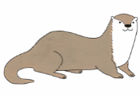
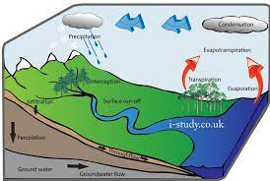
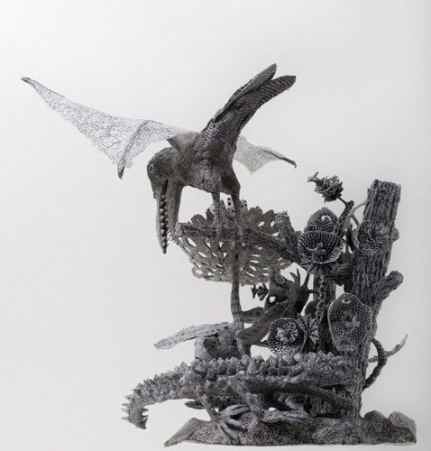
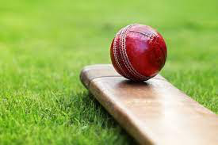
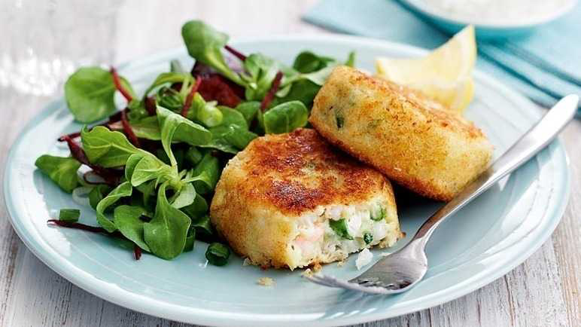
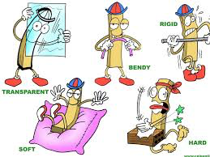
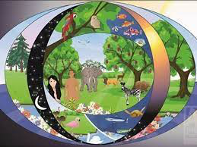
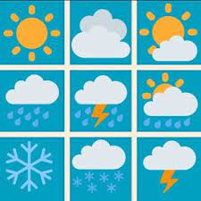
Summer 2 2021
c
Art
Sculpture –papier mache
James Morrison
DT
fish cakes/vegetarian goujons.
Music
Geography
Rivers and the water cycle
PE
Cricket
French
Pack 1 Unit 12 – Quel temps fait-il? (What’s the weather like?)
Science
Computing: Coding
Y4: Boat race
Y5: Catch the dots.
Properties of and changes of materials
PSHE
Valuing Difference
Religious Education
Christianity: Creation Stories
Vocabulary
Conductivity, corrosion, resistance, density, ductility, malleability, elasticity, stiffness, plasticity, toughness, evaporation, condensation, temperature, degrees Celsius, water cycle, basin, estuary, floodplain, delta, tributary, meander, deposition, erosion, confluence, watershed, current, precipitation, transform, value, diversity.

