Slide 1
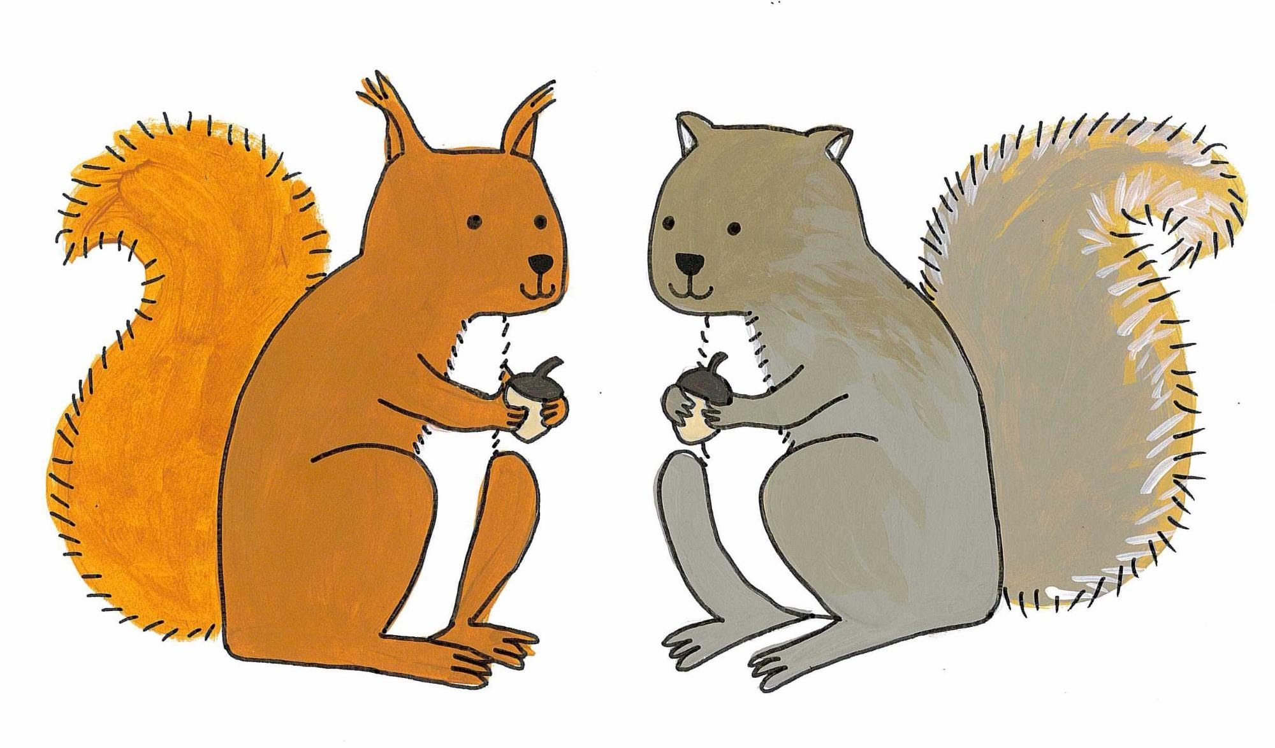
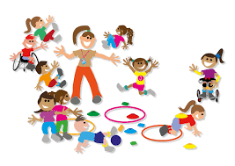
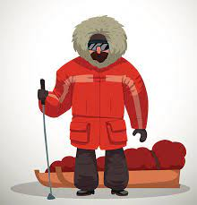
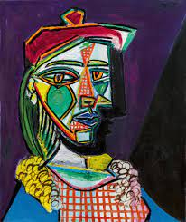
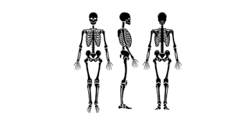
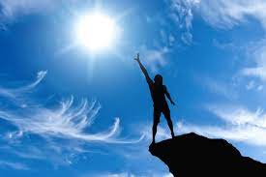
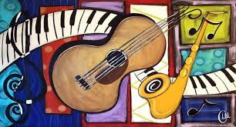
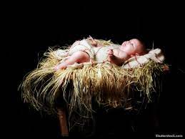
Autumn Term (1) 2021
c
Art and Design
Portraits and self portraits. Picasso study
Joan Miro- sculpture
Computing
E-Safety
PE
Inside: Action Songs Outside: Fundamentals
History
Explorers beyond living memory
Science
Animals including humans
PSHE
Being my best
Music
My stories
Religious Education
Celebrating birthdays
Vocabulary
Equipment, Arctic, older, new, historical, significant, explorer, abstract, portrait, sculpture, sketching, shading, tone, cubism, organs, eyes, ears, mouth, brain, stomach, senses, variation, characteristic, healthy, unhealthy, information, private, safe, internet, balanced diet, wellbeing, collaborative, respiration.

